Slide 1

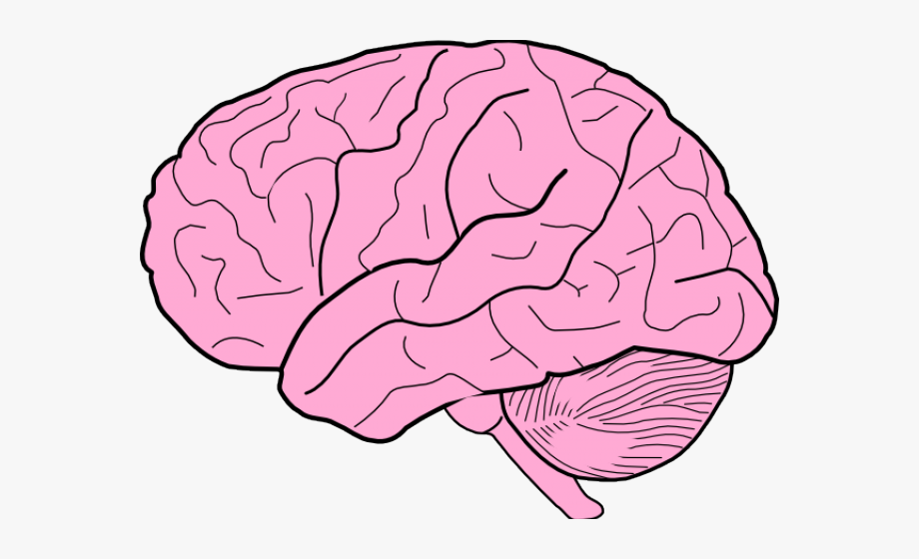
Introduction to Deep Learning

Slide 2
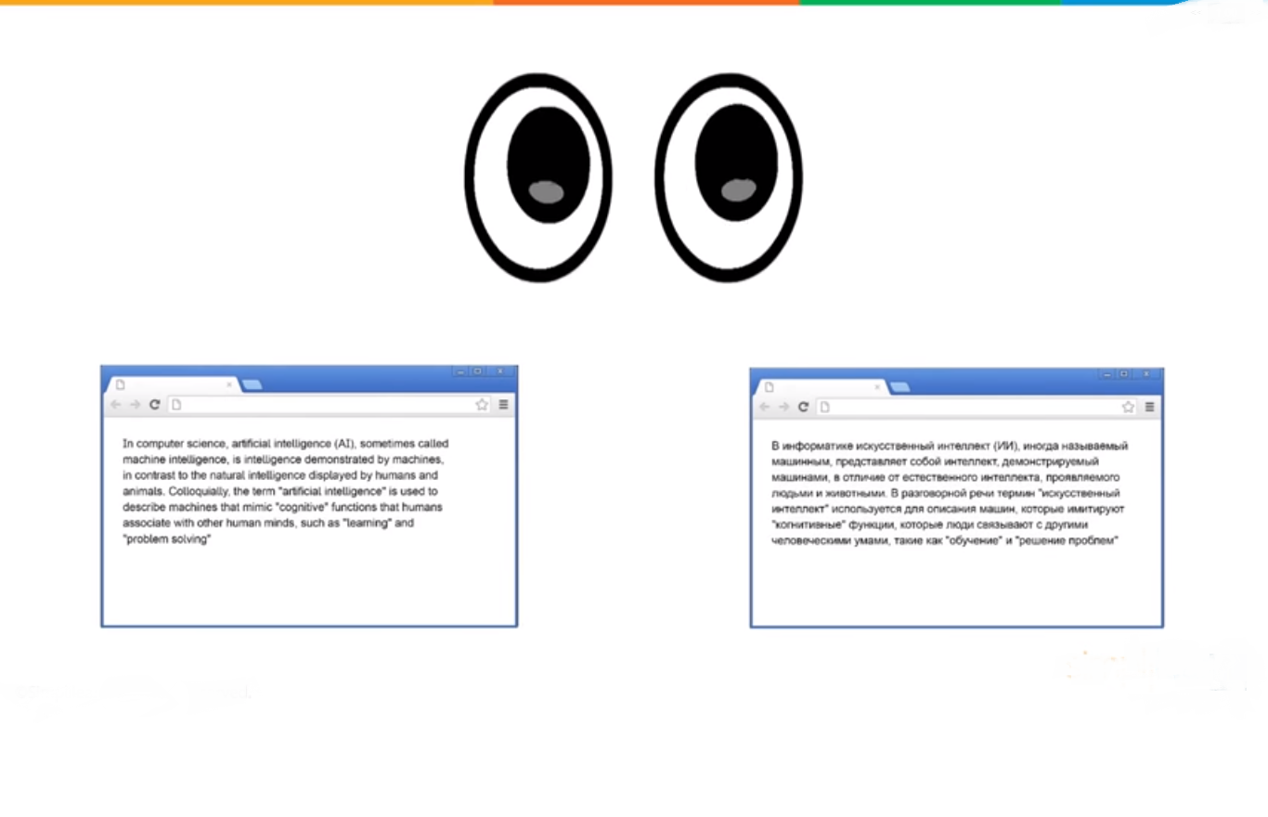


Slide 3


Slide 4


Slide 5

What exactly is Deep Learning?

Slide 6
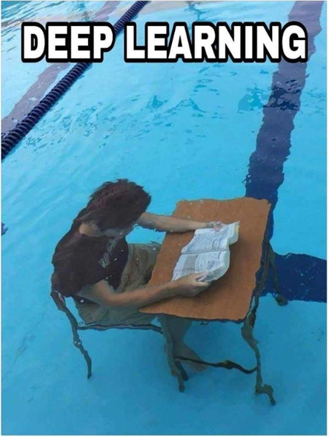

Slide 7
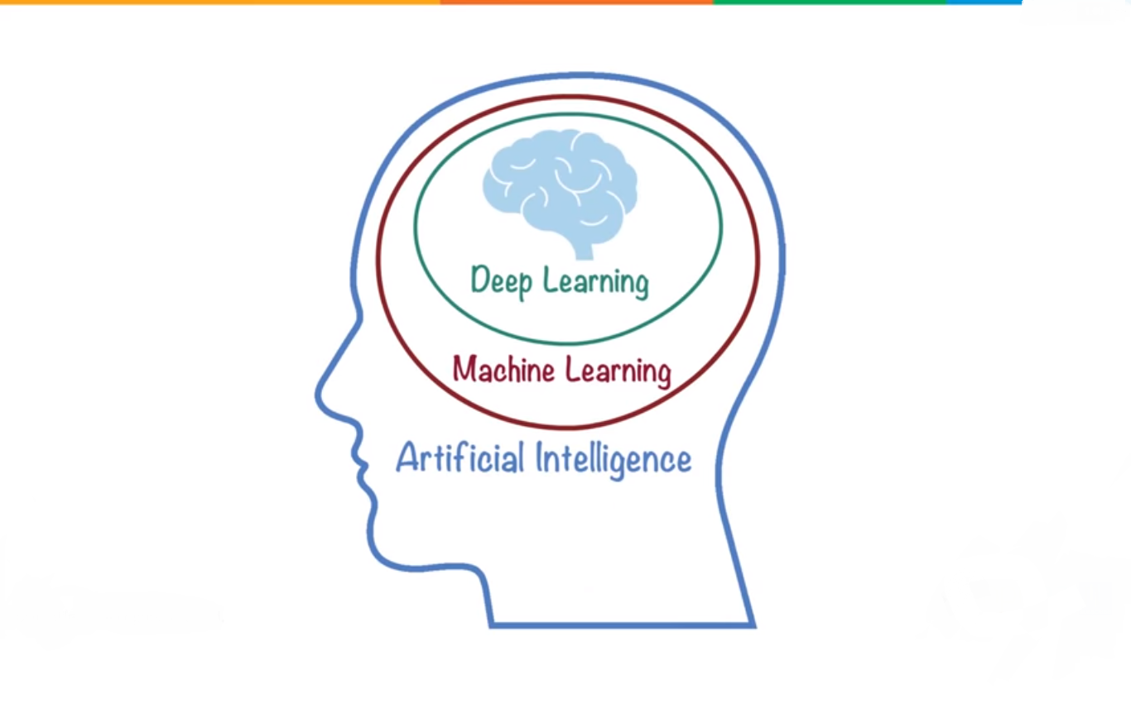

Slide 8
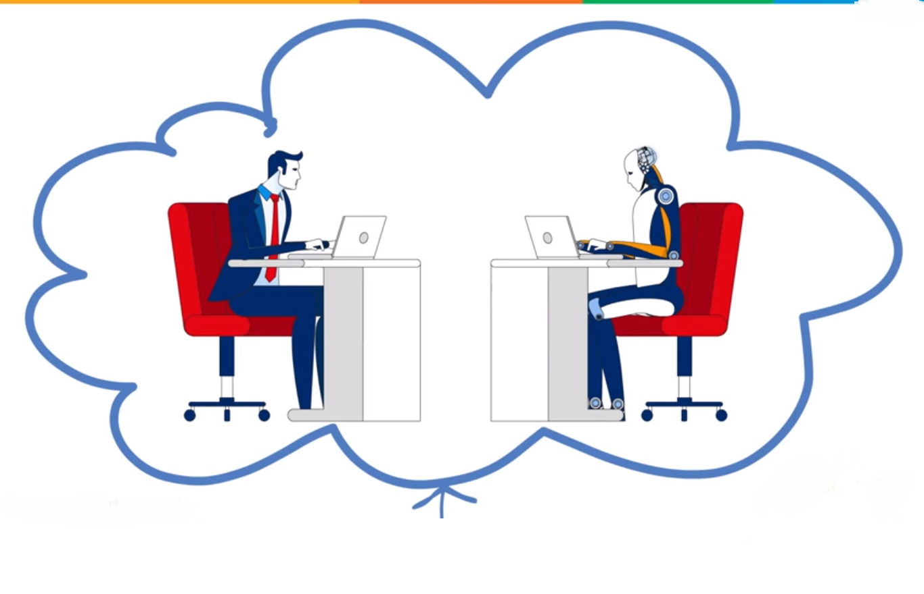

Slide 9
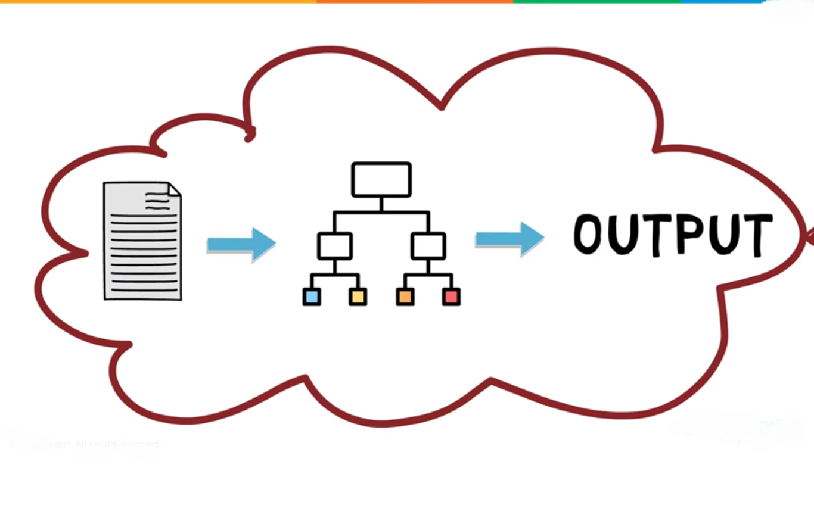

Slide 10
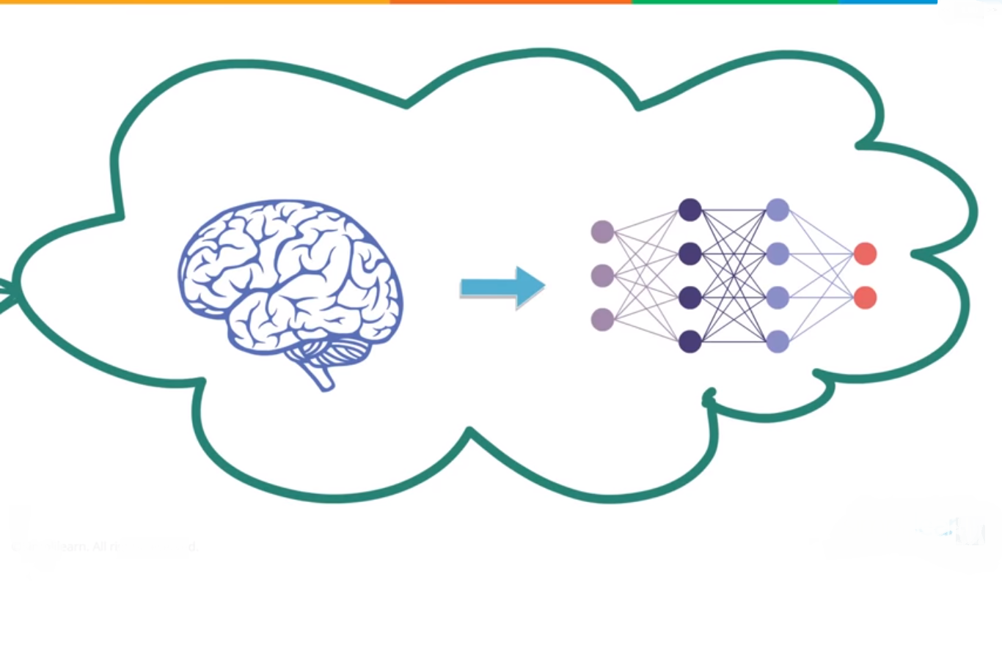

Slide 11
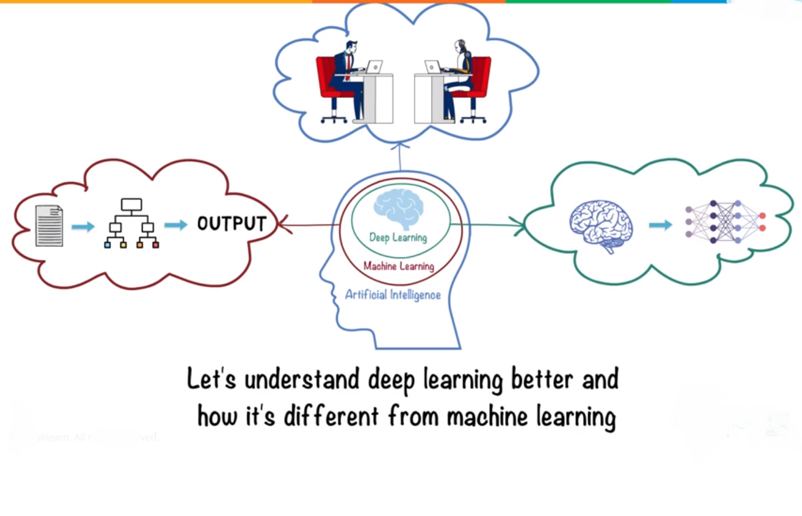

Slide 12
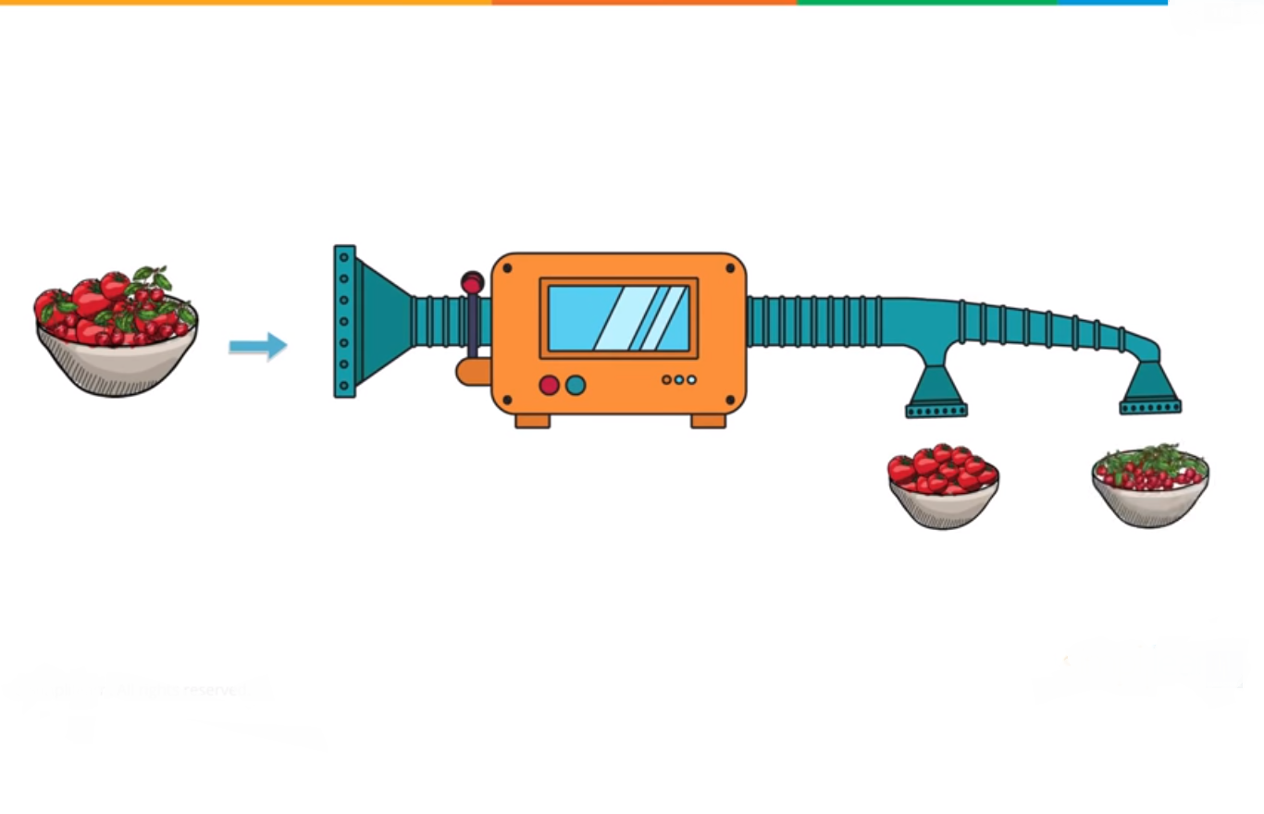

Slide 13
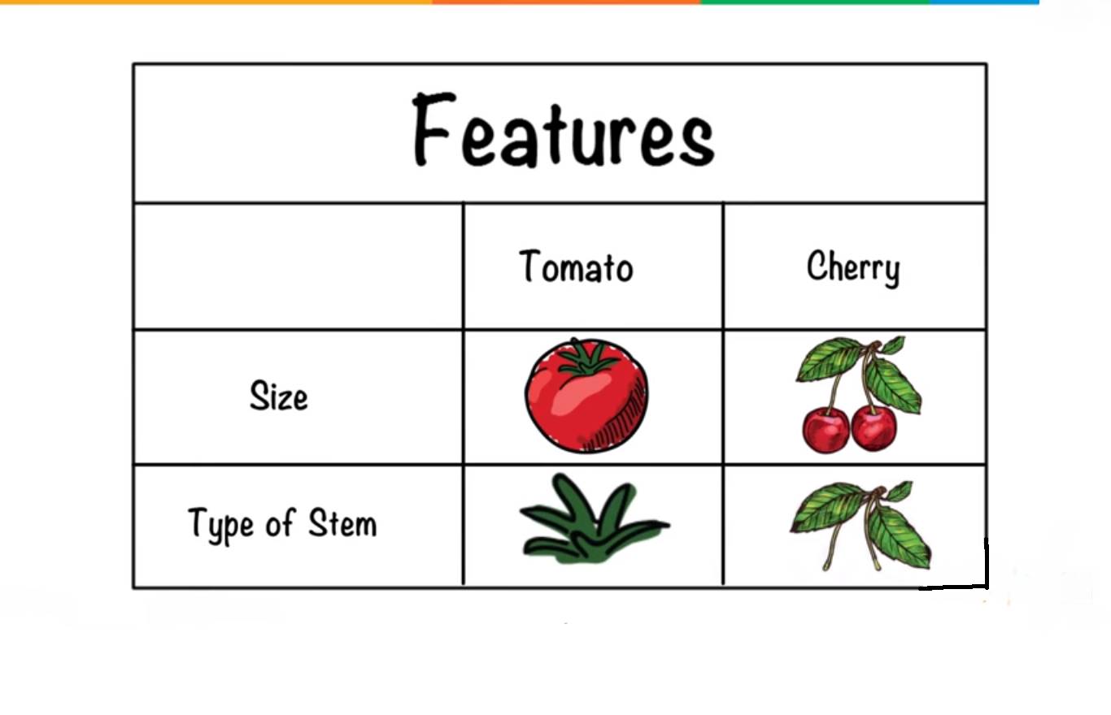

Slide 14
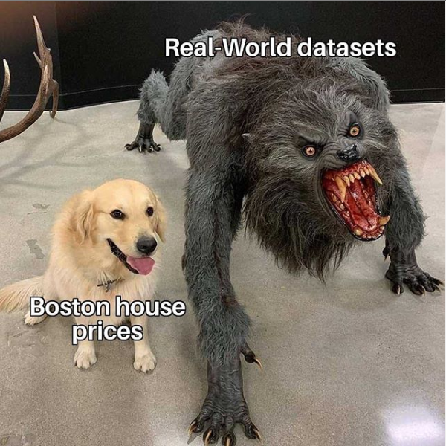

Slide 15
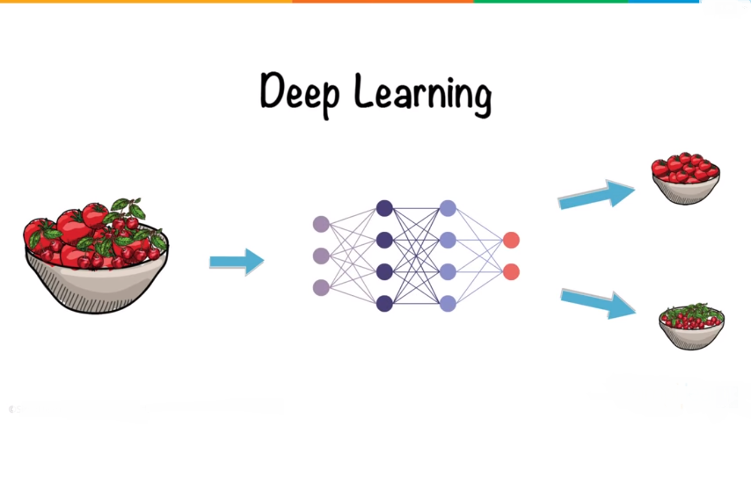

Slide 16
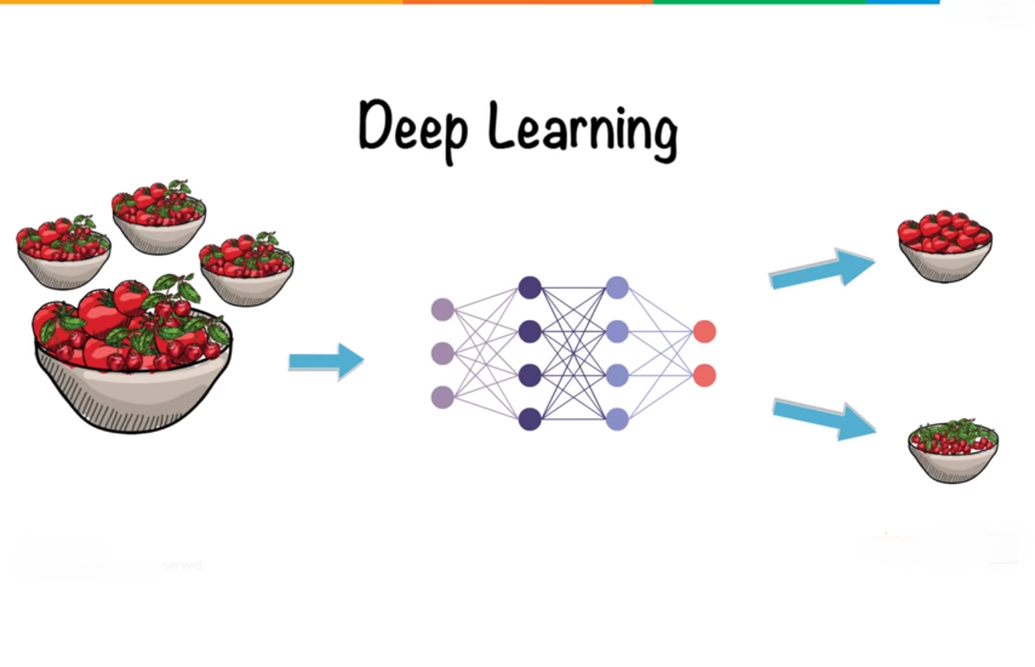

Slide 17


Slide 18
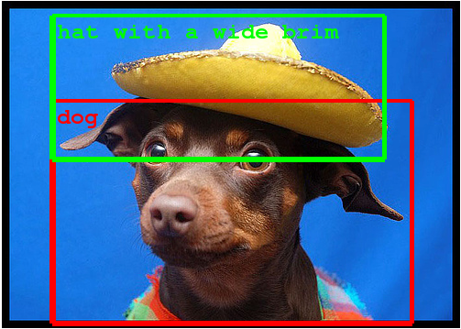
Notes:
so if we see this picture,we see a dog wearing a hat,just this plain picture can confuse your computer,cause dog wearing a hat so what it does is that it makes these boxes at the objects it can identify and identifies it separately,thats the basic image detection

Slide 19
